Slide 1



Dashboard
View in Power BI
Last data refresh:
6/26/2022 4:15:52 PM UTC
Downloaded at:
6/26/2022 4:23:17 PM UTC

Slide 2
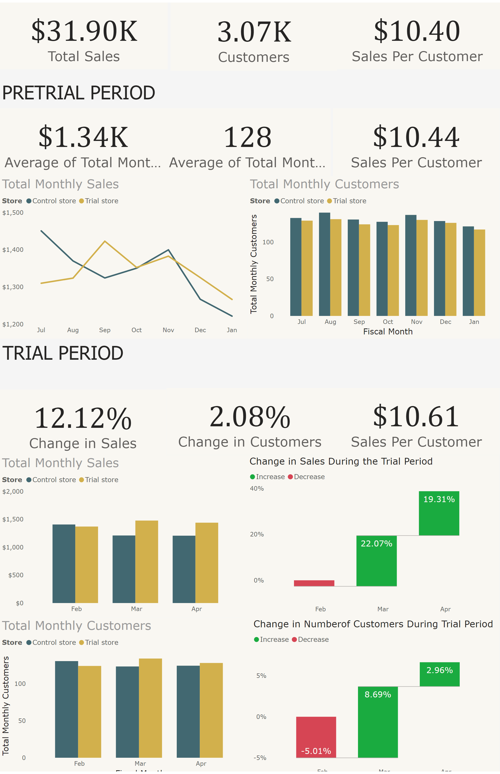
Page 1
Notes:
Total Monthly Sales
No alt text provided
card
No alt text provided
card
No alt text provided
textbox
No alt text provided
card
No alt text provided
Total Monthly Customers
No alt text provided
textbox
No alt text provided
Total Monthly Sales
No alt text provided
Total Monthly Customers
No alt text provided
card
No alt text provided
card
No alt text provided
card
No alt text provided
card
No alt text provided
Change in Sales During the Trial Period
No alt text provided
Change in Numberof Customers During Trial Period
No alt text provided
card
No alt text provided
card
No alt text provided
card
No alt text provided

